Slide 1
Big Data HW #2: DNN and Dimension Reduction
By: Devin Duran

Slide 2
Analysis Overview
Deep learning is one of the hottest and most developing areas within the field of Machine Learning.
Deep learning can handle big data very well; while other networks can also handle big data, they are often times killed by complexity
In today's analysis we will employ DNN on the MNIST and CIFAR-10 datasets along with their embeddings after different dimension reduction methods are performed on them
We will compare the metrics of these models under these different embeddings and under ADAM and SGD optimizers
Given the complexity of the analysis, we use GPU to speed it up

Slide 3
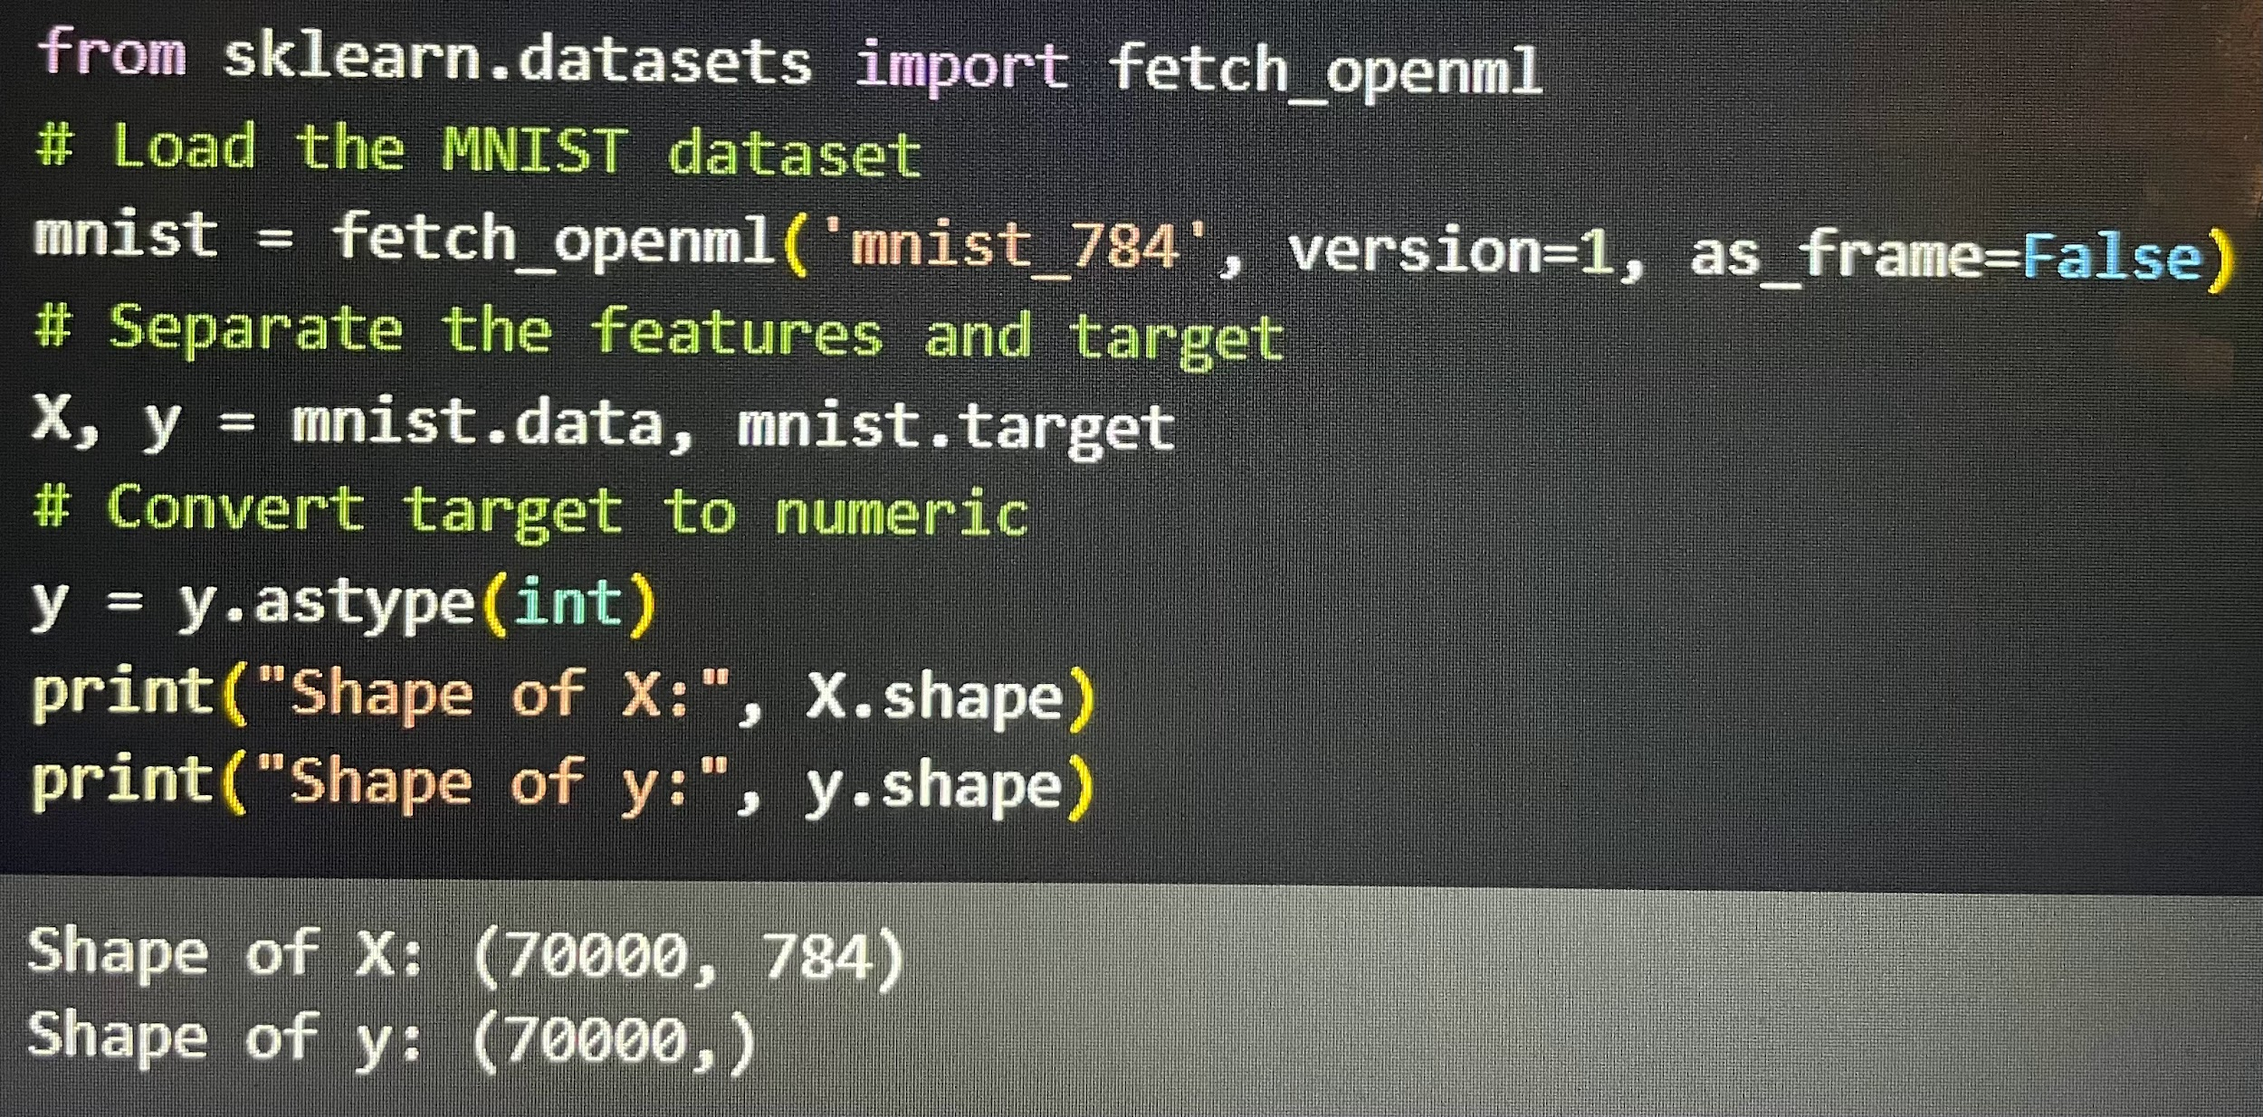
Import MNIST Data
One of two datasets we will be working with today is the MNIST dataset
This dataset is a collection of handwritten digits used to train and test classification systems

Slide 4
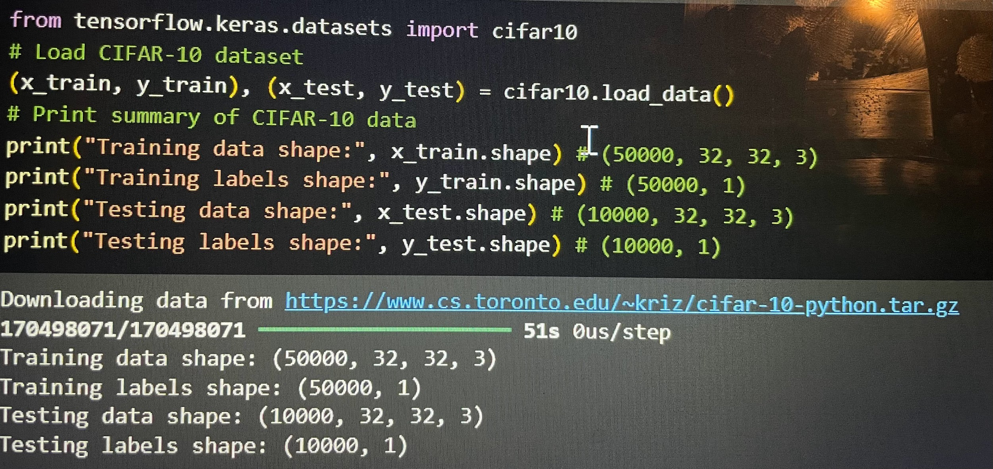
Import CIFAR-10 Data
The other dataset we will be analyzing it the CIFAR-10 dataset
This dataset contains 60000 32x32 pixelated images divided into 10 equal, mutually exclusive classes
The 10 classes are airplanes, cars, birds, cats, deer, dogs, frogs, horses, ships, and trucks

Slide 5
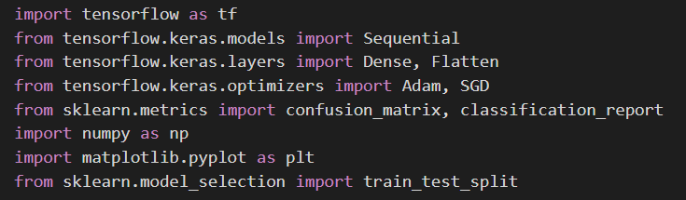
Load Packages

Slide 6
Normalize Pixels
For both datasets, we normalize the pixel values by dividing them by 255
This is because the images of each dataset have different pixel intensity levels ranging from 0 to 255
For the cifar data, we flatten the images to a 1-D array

Slide 7
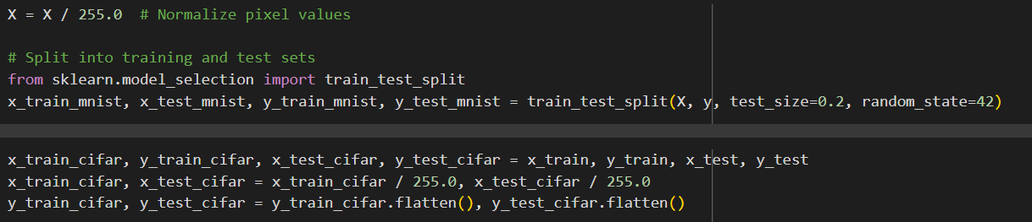
Normalize Pixels

Slide 8
Building, Training, and Evaluating DNN on Non-Reduced Data
We define this function that will run our model, which we will call many times throughout the analysis
We build this DNN with 3 hidden layers, each of which has 200, 100, 50 neurons, to classify the MNIST and CIFAR-10 data dataset
We use the activation function reLU, which introduces non-linearity and can help prevent any vanishing gradient
Vanishing gradient is when loss plateaus and the model doesn't appear to improve even in initial stages of training
The mathematical formula for reLU is max(0, x)
Since there are 10 classes for the data, we insert a softmax layer with 10 neurons

Slide 9
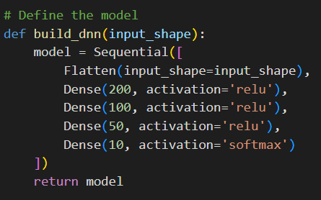

Slide 10
Building, Training, and Evaluating DNN on Non-Reduced Data
We train the model under ADAM and SGD optimizers using 100 epochs
ADAM: adjusts the learning rate for each parameter in a neural network based on its gradient history
SGD: starts with random weights, uses small batches of data, then computes the gradient of these batches before calculating loss function and updating its weights based on it
ADAM is known to have good reproducibility but to be prone to overfitting
SGD is more robust to overfitting, but has worse reproducibility than ADAM

Slide 11
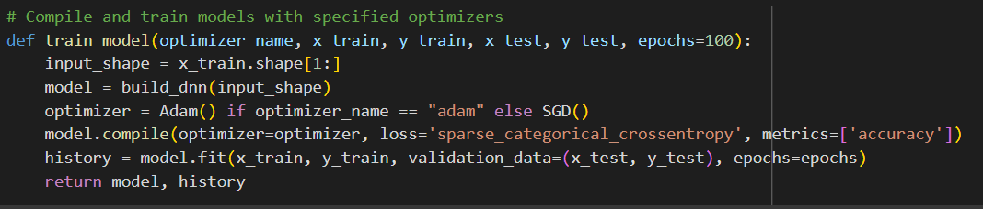
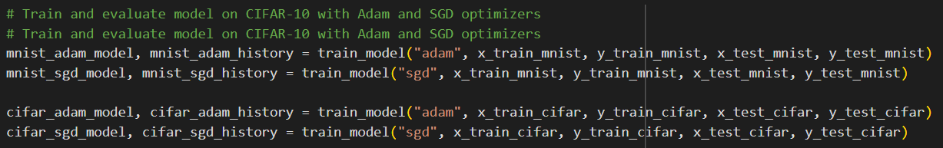

Slide 12
Non-Reduced Data Metrics: Accuracy, Precision, Recall, and F1
We calculate the following metrics for the both DNN models:
Accuracy: How often the model's classification is correct
Precision: How often the model correctly predicts a positive class out of the ACTUAL results
Recall: How often the model correctly predicts a positive class out of the PREDICTED results
F1-Score: Combines precision and recall to evaluate a model's performance
We will create a function that performs all of these metrics and confusion matrix along with one that visualizes the confusion matrix using Seaborn

Slide 13
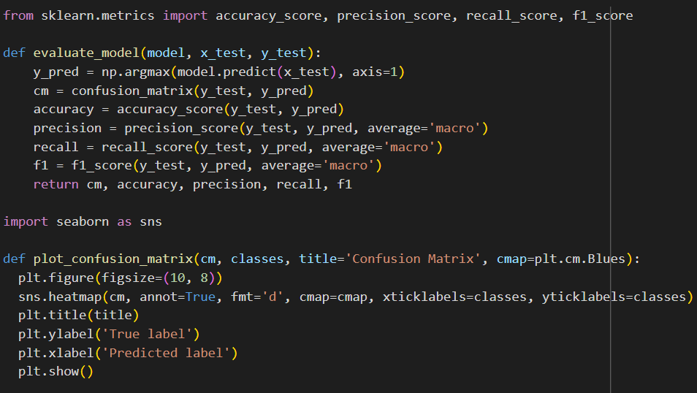

Slide 14
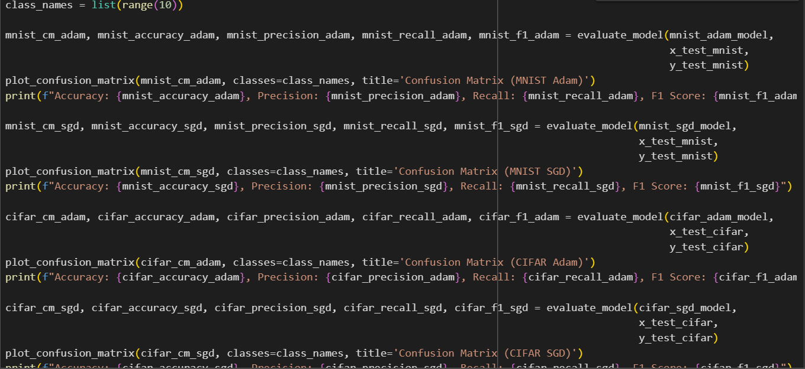

Slide 15
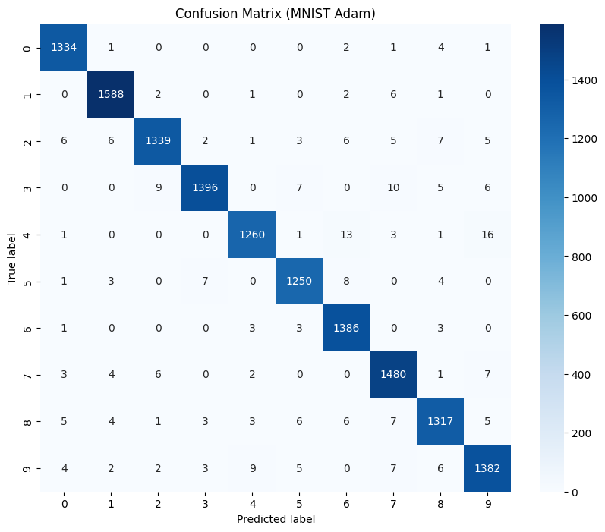

Slide 16


Slide 17
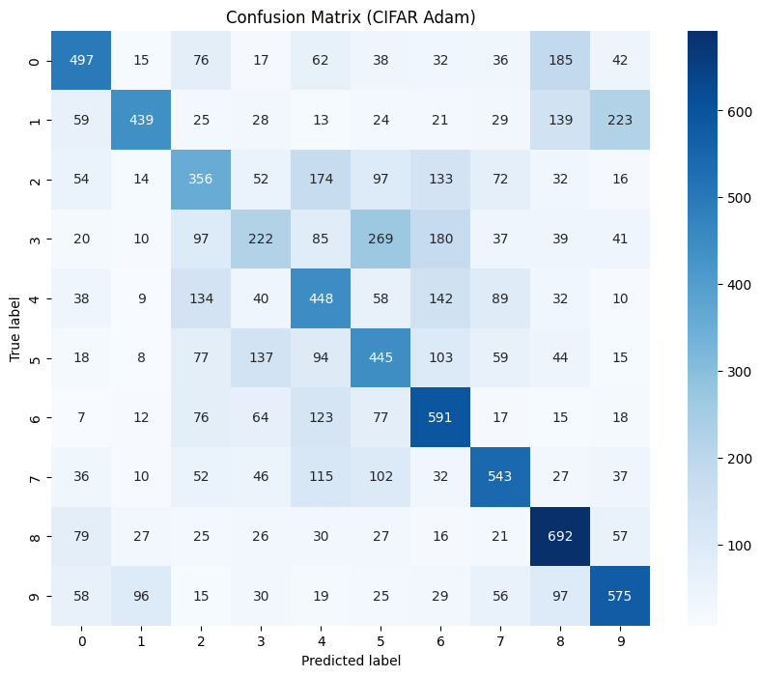

Slide 18
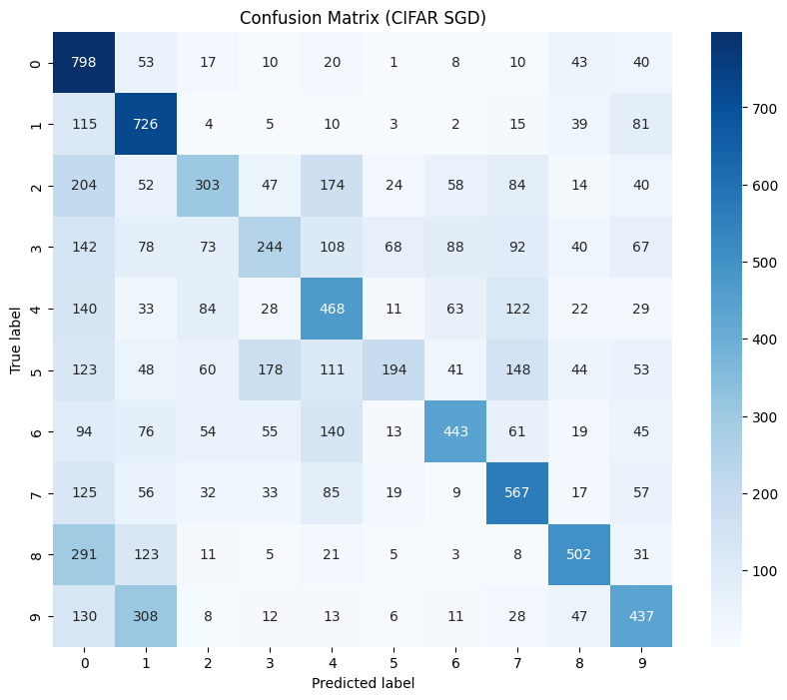

Slide 19
Non-Reduced Data: Metrics Observations
For all four models, whether good or bad performance, all four of their metrics are around the same value
The models for the MNIST data returned metrics of around 0.97-0.98, much better than that of the CIFAR models metrics of about 0.45-0.49
In both methods, ADAM returned better metrics than SGD
However, for CIFAR, SGD had a better precision than that of ADAM

Slide 20
Non-Reduced Data: Plot Loss
We plot the training and validation losses for each model under each dataset and optimizer
The loss used is Sparse Categorical Cross-Entropy Loss, which is the sum of (true labels * log(predicted probability))
If there is a large increase in validation loss or it is significantly larger than the training loss, then the model is overfitting
If the models are relatively equal, then model is neither overfitting or underfitting and is generalizing well to unseen data
The training loss should NOT be larger than the validation loss

Slide 21
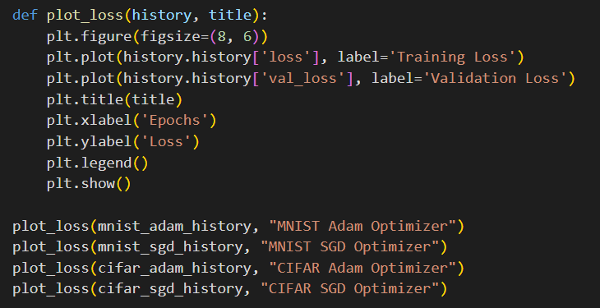

Slide 22
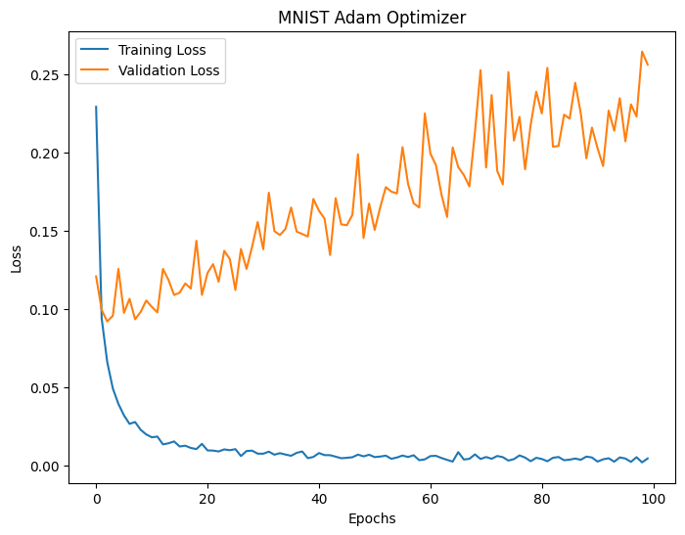

Slide 23
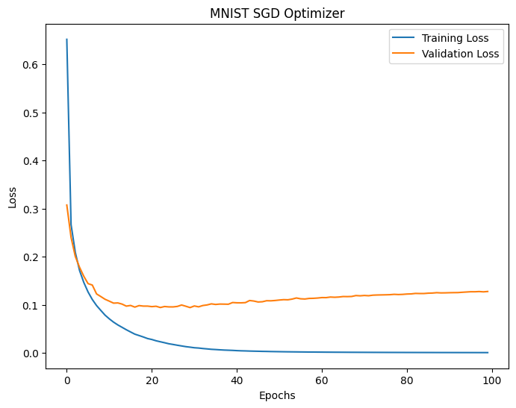

Slide 24
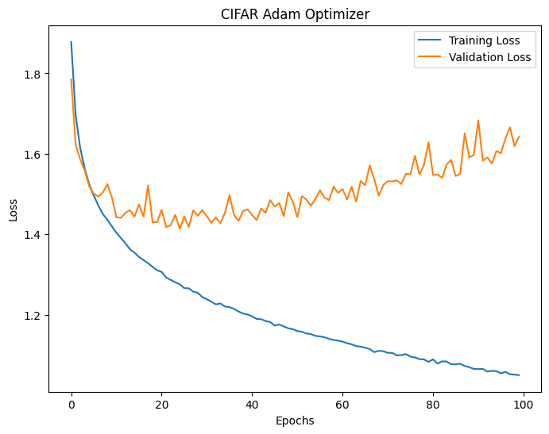

Slide 25
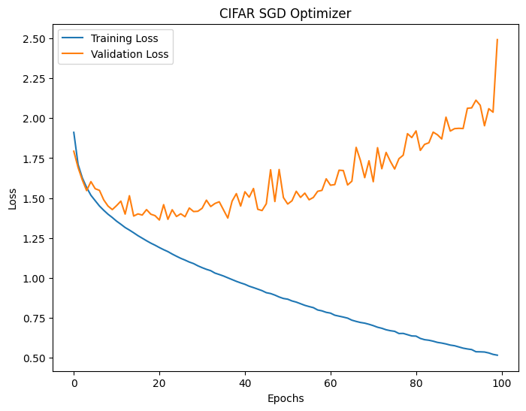

Slide 26
Loss Plot Observations: Non-Reduced Data
3 out of the 4 models experience an scenario where the validation loss greatly exceeds the training loss as more epochs are iterated over
The MNIST SGD model has the least difference between its training and validation loss showing that it has very solid reproducibility

Slide 27
Non-Reduced Data: η and η Ratios
For each loss (training and validation) of each model, we calculate η or eta
The formula for this is η = 1 − (σ/μ+epsilon)^2
The purpose of η is to measure the stability of loss curves
A high η indicates a very stable loss and low η indicates an unstable loss that significantly fluctuates
A good or bad loss stability can help us determine if the training or validation are learning consistently

Slide 28
Non-Reduced Data: η and η Ratios
The η ratio is validation loss/test loss
If the η ratio is close to or equal to 1, then the training and validation have similar stability
If the η ratio is greater than 1, validation loss is more stable than the training, thus creating an overfitting model
If the η ratio is less than 1, the training loss is more stable than the validation loss to challenges in convergence or high noise

Slide 29
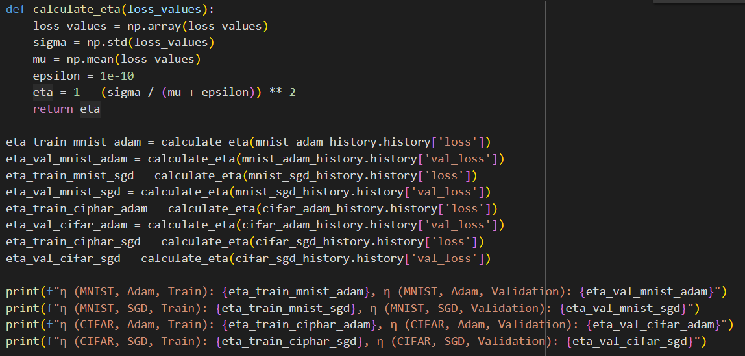

Slide 30
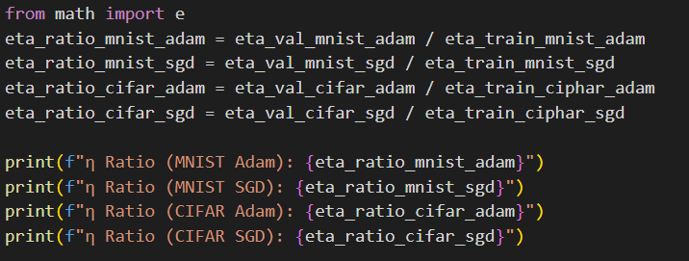

Slide 31
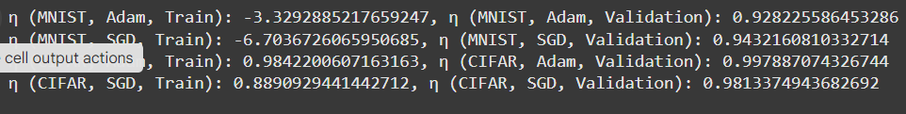
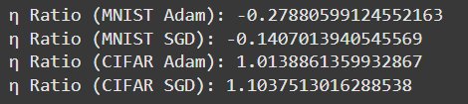
Results

Slide 32
η and η Ratio Observations: Non-Reduced Data
The η ratios are very close to 1 for both CIFAR models
However, surprisingly, the MNIST SGD model, which has been performing very well, is much less than 1 at -0.14
The MNIST Adam ratio is also far from 1 at -0.2788
Overall the CIFAR models are have stable loss functions, where as the MNIST models experience some possible underfitting

Slide 33
Non-Reduced Data Overall Observations
Overall, despite not having the best η ratio and stability, the MNIST models returned much better metrics than the CIFAR models
Typically ADAM is more reproducible than SGD, but it was MNIST's SGD that was by far the most reproducible model
We can conclude that for non-reduced data, the data itself has more effect on whether the model is overfitting, rather than the model itself
From these results, we would like to conclude that the MNIST SGD model performed the best due to its high metrics and reproducibility

Slide 34
Dimension Reduction and Stacking on the DNN Model
For the next part, we will run the same models and conduct the same analyses, but on PCA reduced data and embeddings of stacking using PCA+TSNE and PCA+UMAP
As a refresher:
PCA: a linear dimension reduction method that projects input data to onto a lower-dimensional space that preserves as much data variances as possible
TSNE (t-Distributed Neighbor Embedding): A local, nonlinear dimension reduction method that projects input data to onto a lower-dimensional space
UMAP (Uniform Manifold Approximation and Projection): Another dimension reduction method similar to TSNE that is faster and less random

Slide 35
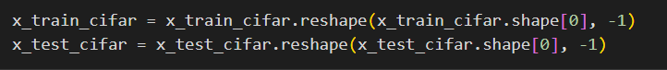
To fit our dimension reduction models, we reshape the training and testing data of the CIFAR-10 data

Slide 36
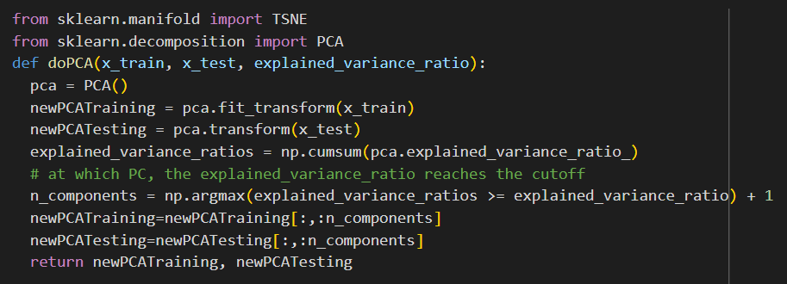
Define PCA Function
We conduct this PCA function while keeping 80% explained variance ratio
We will iterate the TSNE and UMAP functions over the PCA data for the stacking parts of the analysis

Slide 37
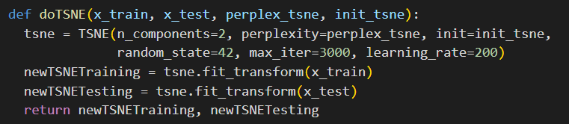
Define TSNE Function
We define the TSNE function using parameters of 2 components, a maximum iterations of 3000, and a learning rate of 200
We will use a perplexity of 30 and PCA initiation method
We will visualize the embeddings of the PCA+TSNE stacking

Slide 38
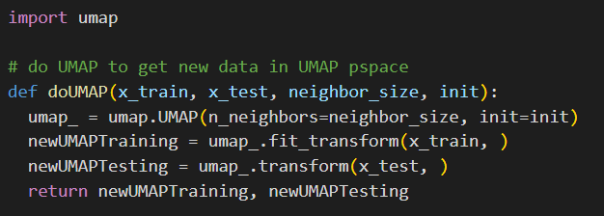
Define UMAP Function
For UMAP we will keep five dimensions, by using neighbor_size=5, and use spectral as our initiation method

Slide 39
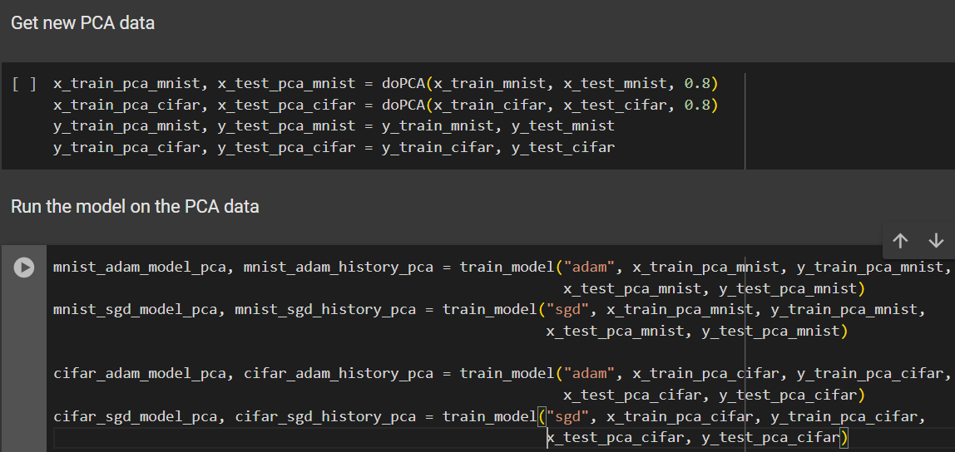
Train and Evaluate DNN on PCA Data

Slide 40
PCA Data Metrics

Slide 41


Slide 42


Slide 43
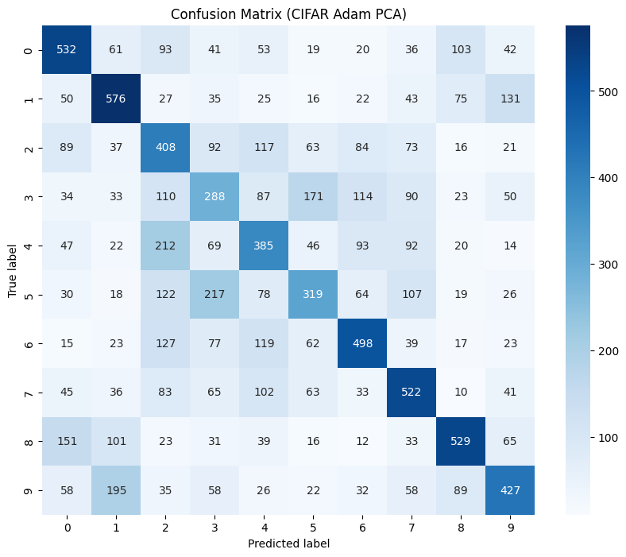

Slide 44
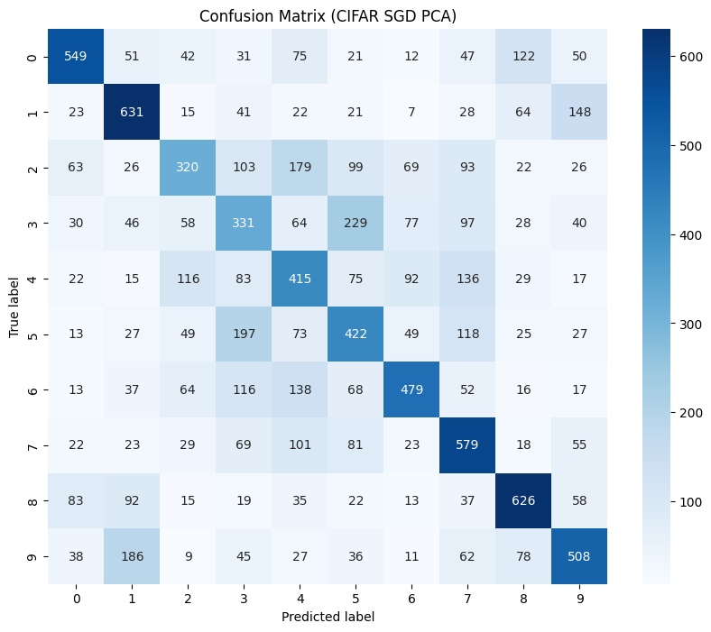

Slide 45
Metrics Observations: PCA Data
Under PCA, the metrics are all very similar to what they were before dimension reduction
Once again, for each model, all four metrics are very similar to each other
However, this time ADAM did not outperform SGD for any of the two datasets
Overall, the metrics of ADAM slightly decreased for both ADAM models, while both SGD models retained pretty much the same metrics across the board

Slide 46
PCA Data: Plot Loss

Slide 47
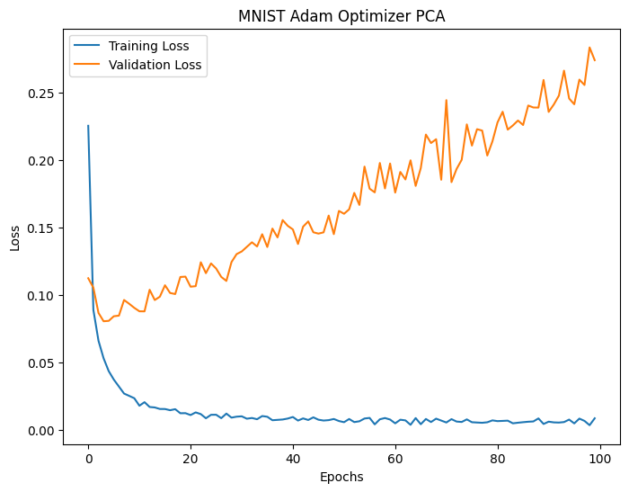

Slide 48
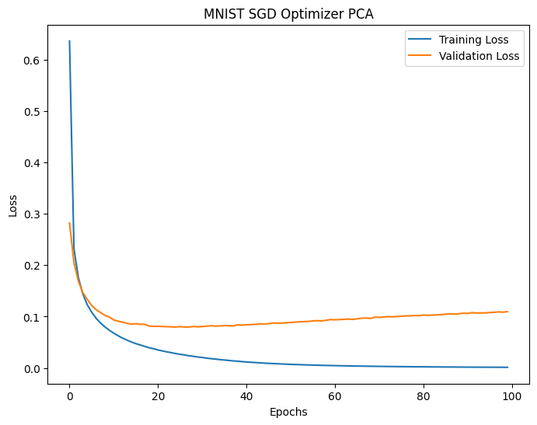

Slide 49
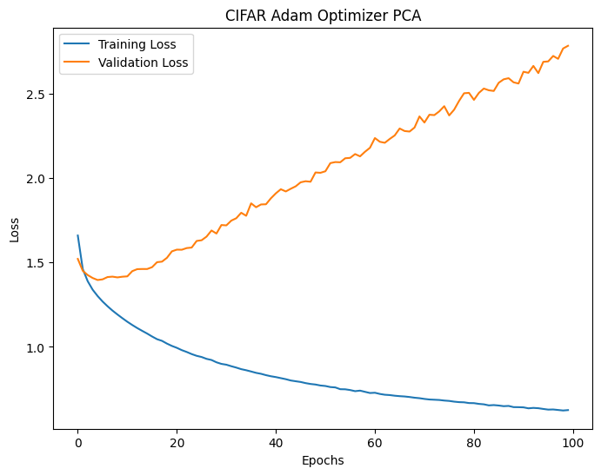

Slide 50
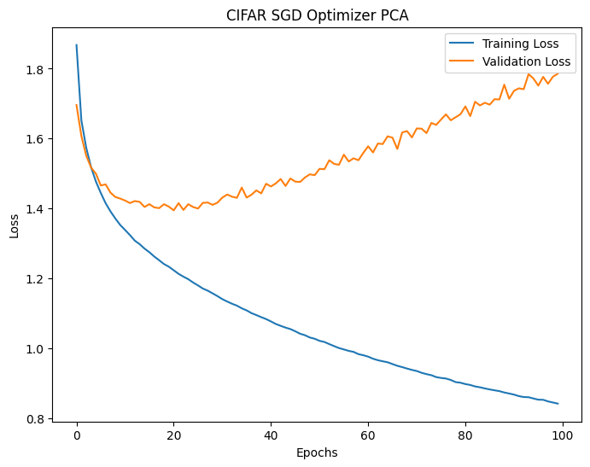

Slide 51
Loss Plot Observations: PCA Data
Similar to the metrics, the visualizations appear similar to the non-reduced data for the most part
Once again, from the visualizations, it appears that SGD would have the best reproducibility, given it has the least validation loss and the most closely related loss curves
However, for both CIFAR models, the validation loss curve is less squiggly leading us to believe it is more stable this time around
Interestingly, the training loss curve for MNIST ADAM is slightly squiggly, being the first training curve so far to have this characteristic

Slide 52
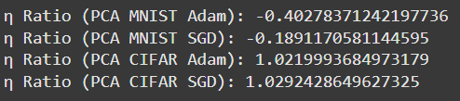
PCA Data: η and η Ratios

Slide 53
η and η Ratio Observations: PCA Data
Similar to before, the stabilities of the MNIST training losses are very low under both optimizers
Both CIFAR-10 models appear very stable with η values near one for each of their respective losses
The ratios are low once again for the MNIST models and even closer to 1 than before for the CIFAR-10 models, both returning η ratios of about 1.02
Judging by the η metrics, we can assume that the CIFAR models are more consistent while the MNIST models are prone to underfitting

Slide 54
PCA Data Overall Observations
Similar to the non-reduced data, MNIST had much better metrics but much worse η and η ratios compared to the CIFAR-10 models
Once again we can see that it is the dataset itself, rather than the optimizer that plays a bigger part in most aspects of performance
The MNIST ADAM model was just flat out unstable with very low η for both loss curves
PCA made some slight improvements to the models, mostly in the reproducibility, but overall each of the models performed just about the same

Slide 55
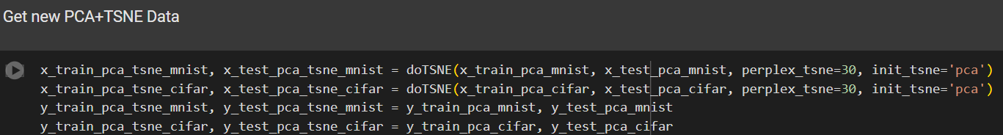
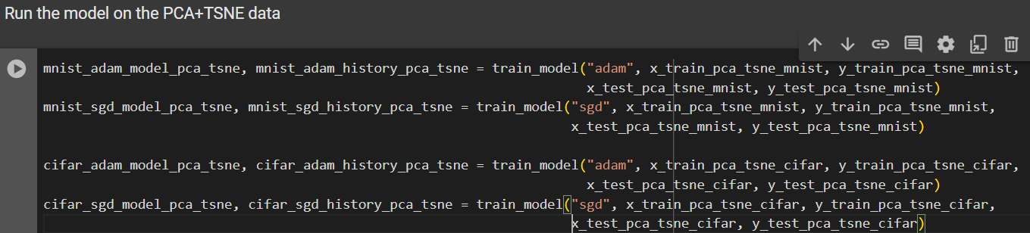
Training and Evaluating DNN on PCA+TSNE Stacking Data

Slide 56
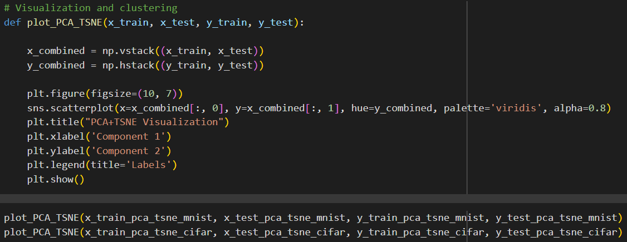
Visualize PCA+TSNE Embeddings

Slide 57
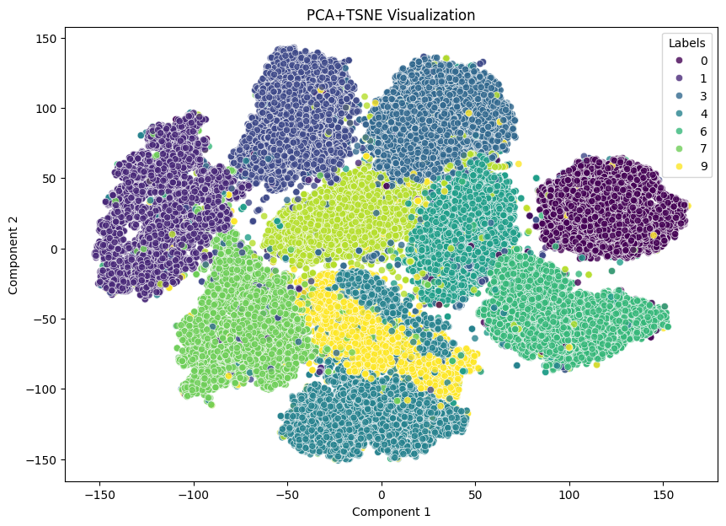
ADAM

Slide 58
SGD

Slide 59
PCA+TSNE Plot Observations
The visualization performance of the MNIST data is much better than that of CIFAR-10
The plot divides it into very distinct and visible clusters, while the CIFAR-10 plot contains way too much overlap in one giant glob
Considering the type of data we are working with is flattened image data containing different digits or classes, the clustering performance visually is very important

Slide 60
PCA+TSNE Stacking Data: Metrics

Slide 61
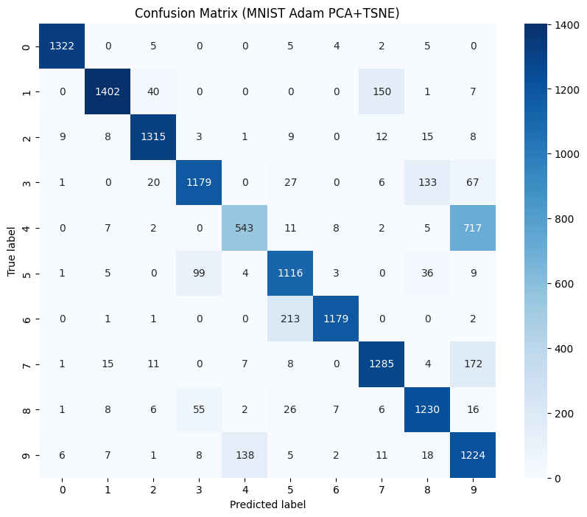

Slide 62
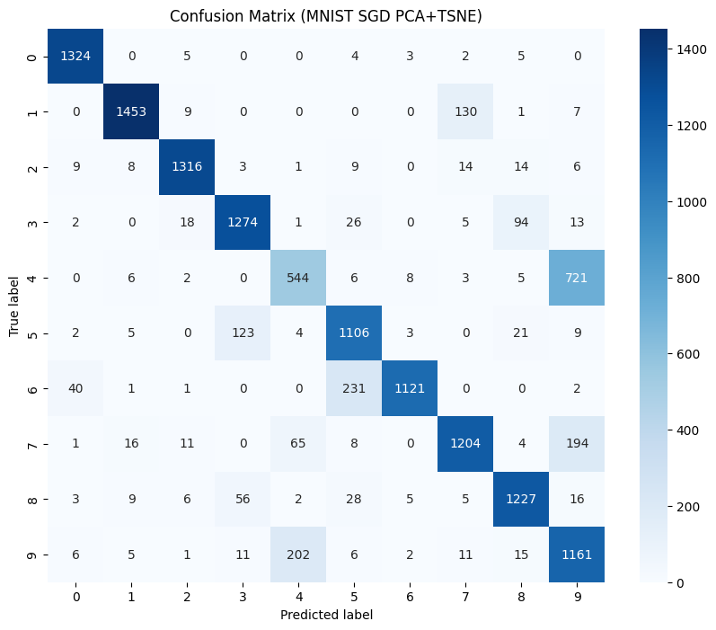

Slide 63
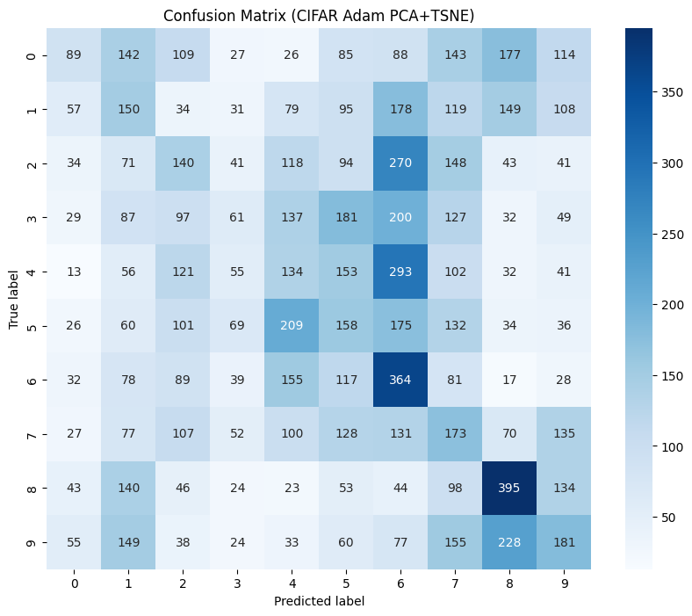

Slide 64
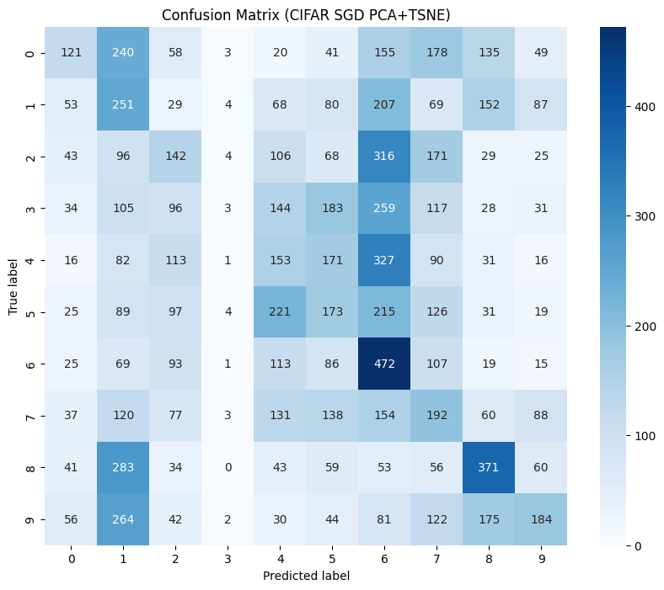

Slide 65
Metrics Observations: PCA+TSNE Stacking Data
The metrics come down to earth for the MNIST models, going from about 0.97-98 in the first two analyses to about 0.83-85 for the stacking data
However, the metrics for the CIFAR-10 models fall off a cliff, going all the way down to about 0.18 for ADAM and 0.20 for SGD
Similar before though, each of the four metrics for the respective models are all about the same, once again showing balanced classes

Slide 66
PCA+TSNE Stacking Data: Plot Loss

Slide 67
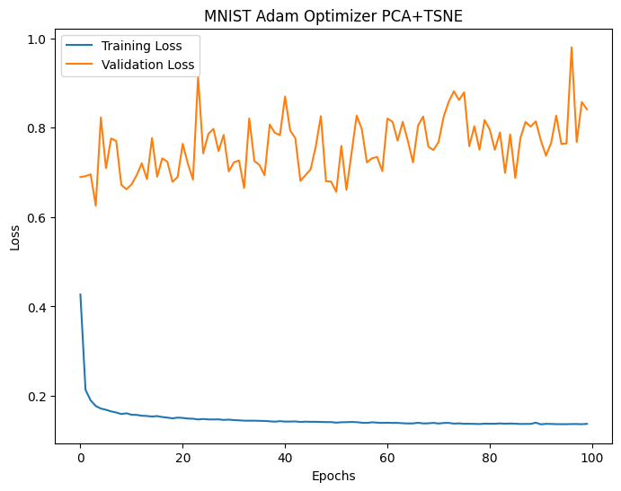

Slide 68
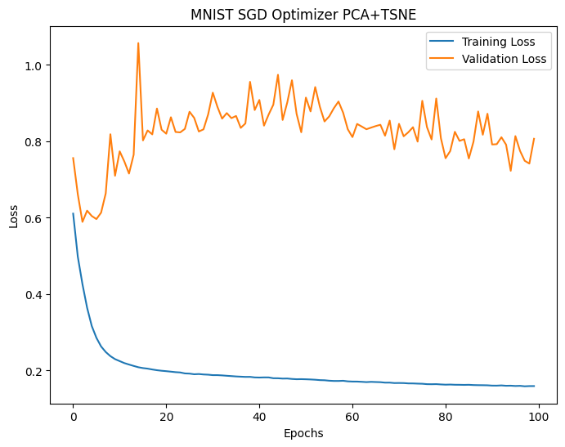

Slide 69
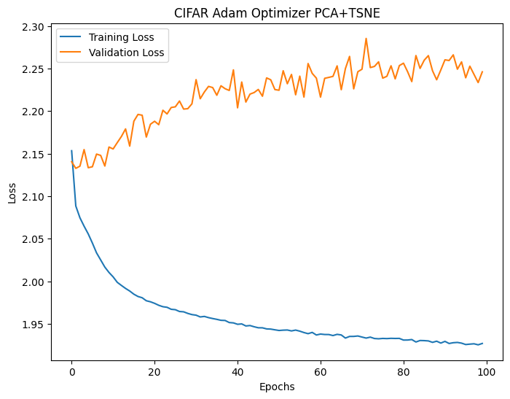

Slide 70
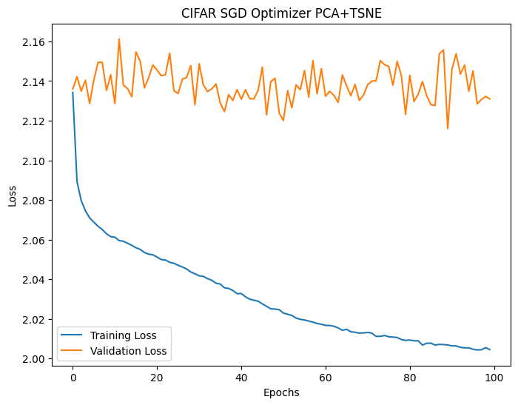

Slide 71
Loss Plot Observations: PCA+TSNE Stacking Data
For each of the four loss plot visualizations, the validation loss is far from the training loss
This is the same as before with the exception of the MNIST SGD model, which in the prior two analyses had the two curves not too far from each other with a much lesser validation loss
Every curve for each loss is much more squiggly then in the last two analyses
However, the validation losses overall, don't seem to increase with the epochs with the exception of the CIFAR-10 ADAM model, so we might expect some more stable curves
The MNIST SGD model which had by far the best reproducibility under the first two datasets, is now similar to the others, which by the look of the loss plots did not change much

Slide 72
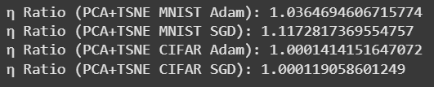
PCA+TSNE Stacking Data: η and η Ratios

Slide 73
η and η Ratio Observations: PCA+TSNE Stacking Data
As we hinted at, the η values for each model's training and validation losses were all high indicating a great amount of stability
With this balance, we are greeted with η ratio values all close to 1
The CIFAR-10 models are almost 1 right on the dot, only ten-thousandths greater
The MNIST models are slightly above 1, but are a major improvement over how they performed in the previous two analyses
The ADAM MNIST is more stable than that of the SGD model with a η ratio closer to 1

Slide 74
PCA+TSNE Stacking Data Overall Observations
For the first time in the entire analysis so far, we observed signifcant change in multiple categories
Both models lost a bit of their accuracy and other metrics, CIFAR-10 being hit very hard and having very poor performance in that regard
The MNIST SGD model was much more similar to the other models this go round, no longer having vastly superior reproducibility
The η values and ratios were improved and much more similar between the four models

Slide 75
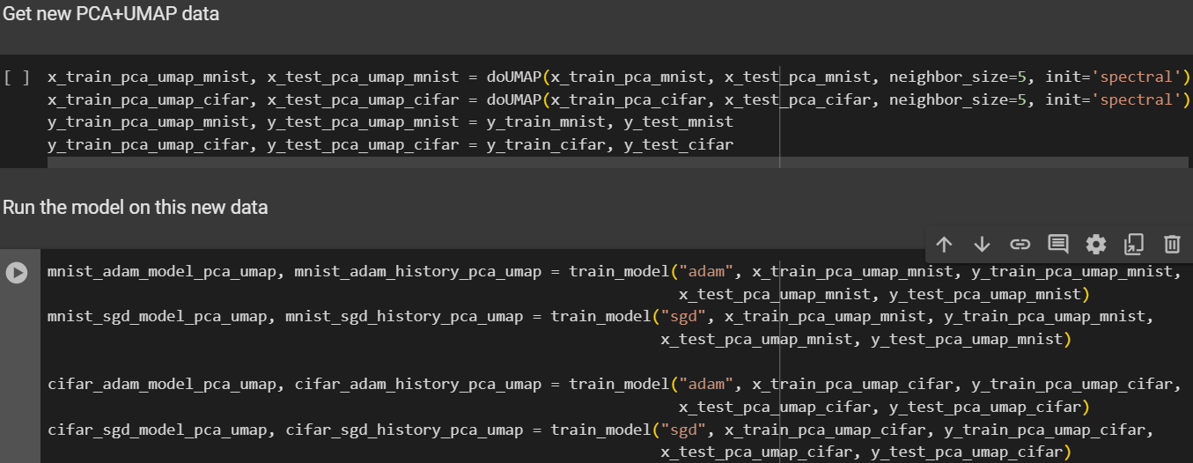
Training and Evaluating DNN on PCA+UMAP Stacking Data

Slide 76

PCA+UMAP Stacking Data Metrics

Slide 77


Slide 78
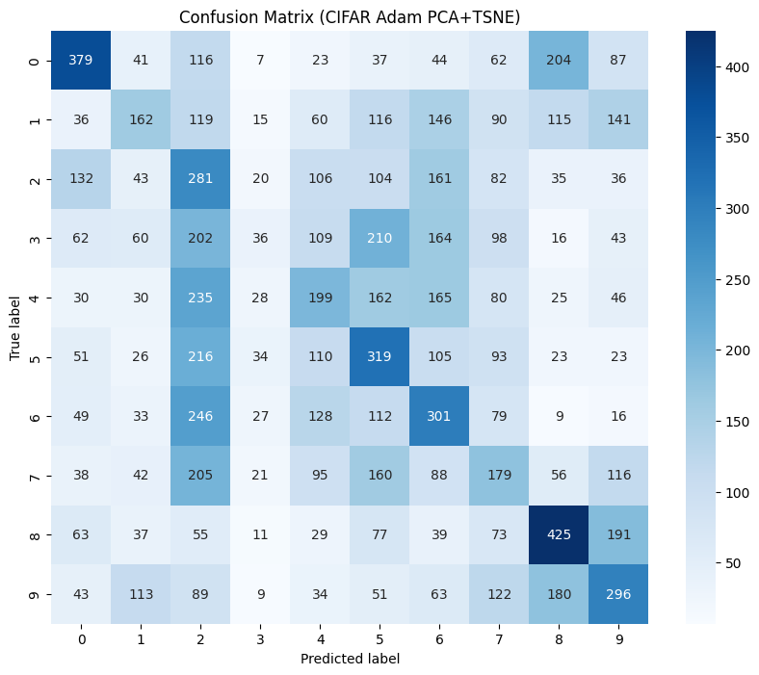

Slide 79
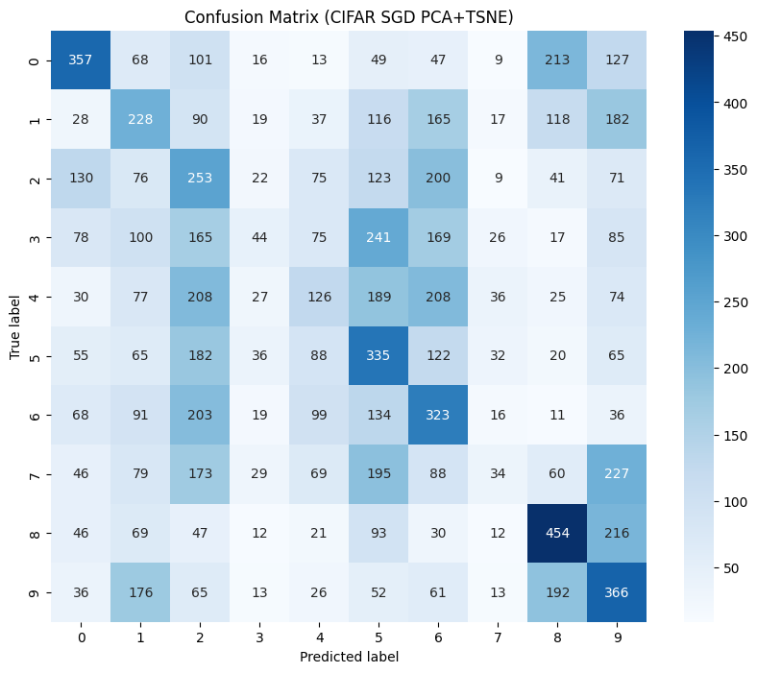

Slide 80
Metrics Observations: PCA+UMAP Stacking Data
The metrics here are more similar to that of the PCA+TSNE embeddings rather than the first two
They are slightly improved for each model, however with the MNIST models going up to about 0.90, and the CIFAR-10 models increasing to about 0.25
The optimizers perform about the same for MNIST, but ADAM slightly outperforms SGD in its precision and F1 score for CIFAR-10
A common pattern we see here is the balance of classes

Slide 81
PCA+UMAP Stacking Data: Plot Loss

Slide 82
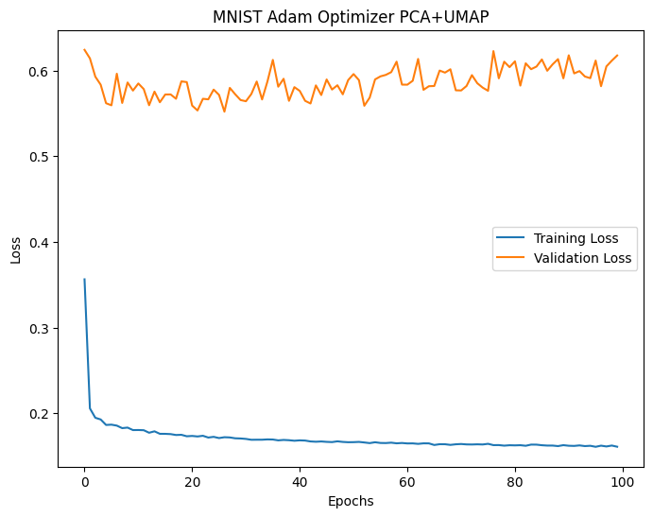

Slide 83


Slide 84


Slide 85


Slide 86
Loss Plot Observations PCA+UMAP Stacking Data
Where we didn't see too much change when it came to the metrics that is not the case at all for the loss plot visualizations
It would appear that we have some of our best performances under this embedding
The CIFAR models have the closest related validation and training loss curves, leading us to assume that they have very good reproducibility
The SGD for CIFAR has nearly identical curves
For MNIST however, there is great distance between the two curves
Similar to the previous stacking method, there isn't too much change in the validation loss outside of the first few epochs, suggesting that these curves are indeed stable

Slide 87

PCA+UMAP Stacking Data: η and η Ratios

Slide 88
η and η Ratio Observations: PCA+UMAP Stacking Data
Similar to PCA+TSNE, the η ratios for both CIFAR-10 models are nearly 1 right on the dot
This time however, MNIST ADAM improves to 1.01, also becoming a nearly perfect stable model
The MNIST model improves as well, but is brought down by a η training value of 0.89, which although good, is not as high as the others

Slide 89
Overall Observations: PCA+UMAP Stacking Data
PCA+UMAP appeared to be a better fit for these data and models than that of PCA+TSNE
The reproducibility of the CIFAR models experienced vast improvement here, even if it meant that the MNIST models, mainly SGD were not as good as they were under the non-reduced and PCA data
The metrics although not as good as the original and PCA data, were better than that of PCA+TSNE while once again maintaining class balance
The stability was improved here over the previous three analyses illustrating models least prone to underfitting and overfitting

Slide 90
Conclusion
Today, we ran many different algorithms and models, which even with the help of GPU was definitely tedious
In the majority of the cases, it was the data itself that greater effects on metrics and overall performance than the optimizer methods
Although the metrics were not great at all for any of the CIFAR-10 data, there was not any class imbalance for a single model ran today
Overall, there was no specific model that we could say was the best; each dimension reduction method, data, or optimizer had its many different pros and cons, with many attributes being a trade off for one another, which is what defines the complex challenge that is Big Data and Deep Learning

